Slide 1
Comparison of General and Stratified Survival Analysis (Deep Learning Perspective)
Prof. Junetae Kim
lyjune0070@gmil.com

Slide 2
Learning Objectives
Understand the Cox Proportional Hazards Model and its assumptions.
Learn the derivation of MLE for general survival analysis.
Explore stratified survival analysis and its theoretical basis.
Compare the performance of general and stratified models using case studies.

Slide 3
Chapter 1
Foundations of Survival Analysis

Slide 4
What is Survival Analysis?
Definition: A statistical approach to modeling time until an event occurs.
Examples:
Biomedical research: Predicting time to death or disease relapse.
Industrial applications: Machine failure time.

Slide 5

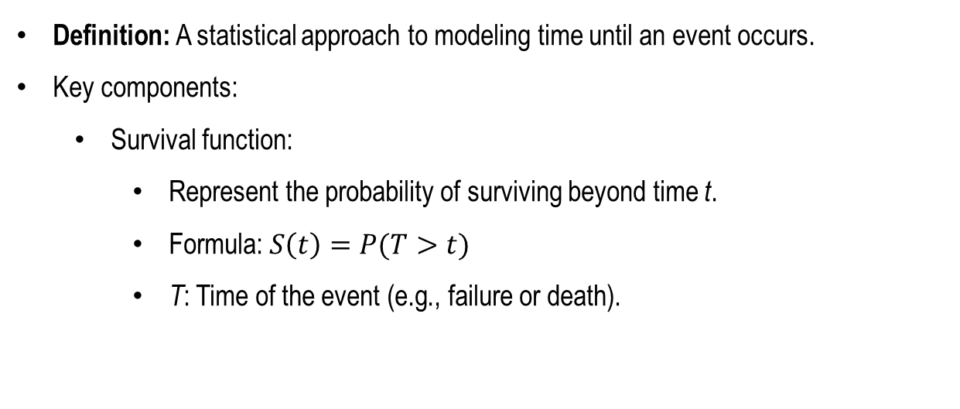

What is Survival Analysis?
Definition: A statistical approach to modeling time until an event occurs.
Key components:
Survival function:
Represent the probability of surviving beyond time t.
Formula: $S\left(t\right)=P(T>t)$
T: Time of the event (e.g., failure or death).
Surv. rate
$$T$$
$$t$$

Slide 6
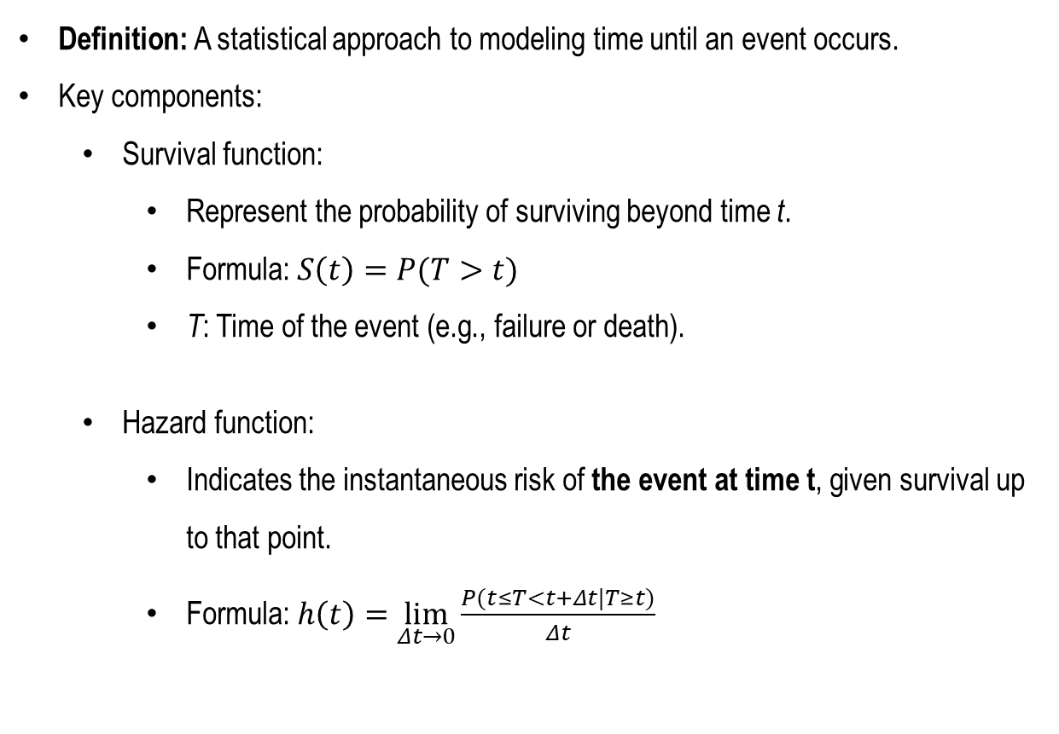


What is Survival Analysis?
Definition: A statistical approach to modeling time until an event occurs.
Key components:
Survival function:
Represent the probability of surviving beyond time t.
Formula: $S\left(t\right)=P(T>t)$
T: Time of the event (e.g., failure or death).
Hazard function:
Indicates the instantaneous risk of the event at time t, given survival up to that point.
Formula: $h\left(t\right)=\lim_{Δt→0}{\frac{P(t≤T<t+Δt|T≥t)}{Δt}}$
Surv. rate
$$T$$
$$t$$
Risk
$$T$$
$$t$$

Slide 7
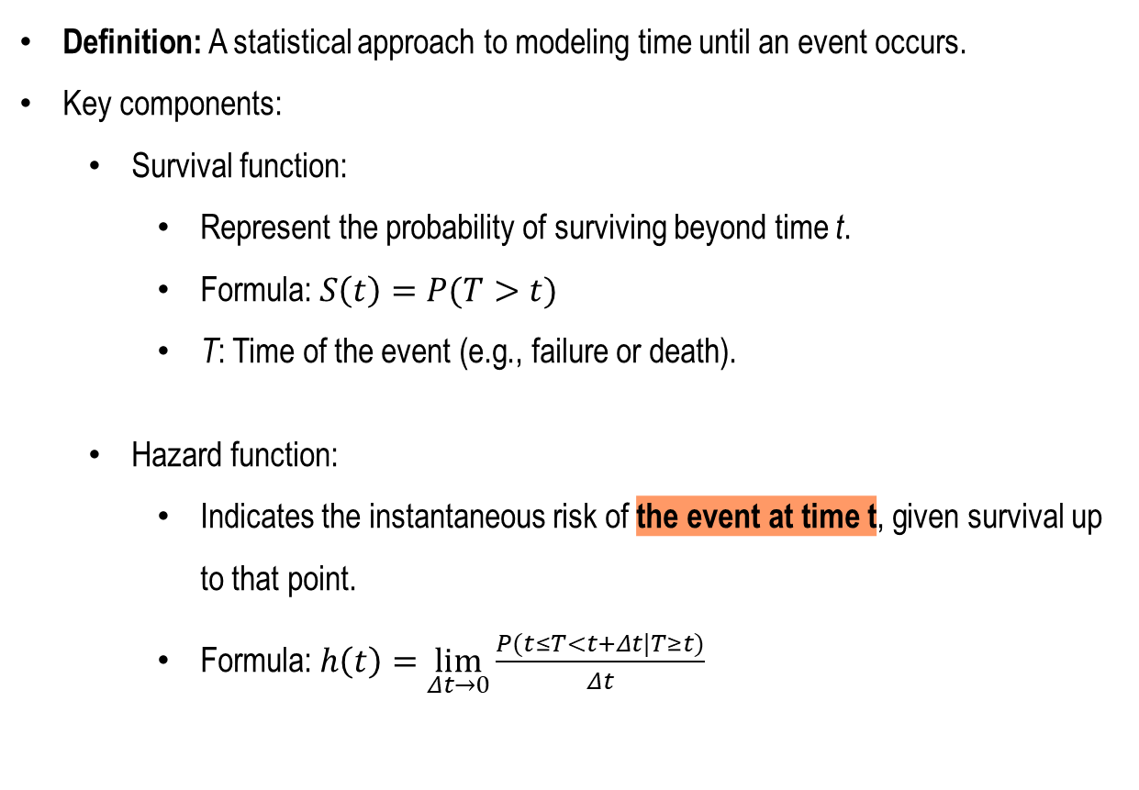
What is Survival Analysis?
Definition: A statistical approach to modeling time until an event occurs.
Key components:
Survival function:
Represent the probability of surviving beyond time t.
Formula: $S\left(t\right)=P(T>t)$
T: Time of the event (e.g., failure or death).
Hazard function:
Indicates the instantaneous risk of the event at time t, given survival up to that point.
Formula: $h\left(t\right)=\lim_{Δt→0}{\frac{P(t≤T<t+Δt|T≥t)}{Δt}}$
Surv. rate
$$T$$
$$t$$
Risk
$$T$$
$$t$$

Slide 8
What is Survival Analysis?
Definition: A statistical approach to modeling time until an event occurs.
Key components:
Survival function:
Represent the probability of surviving beyond time t.
Formula: $S\left(t\right)=P(T>t)$
T: Time of the event (e.g., failure or death).
Hazard function:
Indicates the instantaneous risk of the event at time t, given survival up to that point.
Formula: $h\left(t\right)=\lim_{Δt→0}{\frac{P(t≤T<t+Δt|T≥t)}{Δt}}$
Surv. rate
$$T$$
$$t$$
Risk
$$T$$
$$t$$

Slide 9
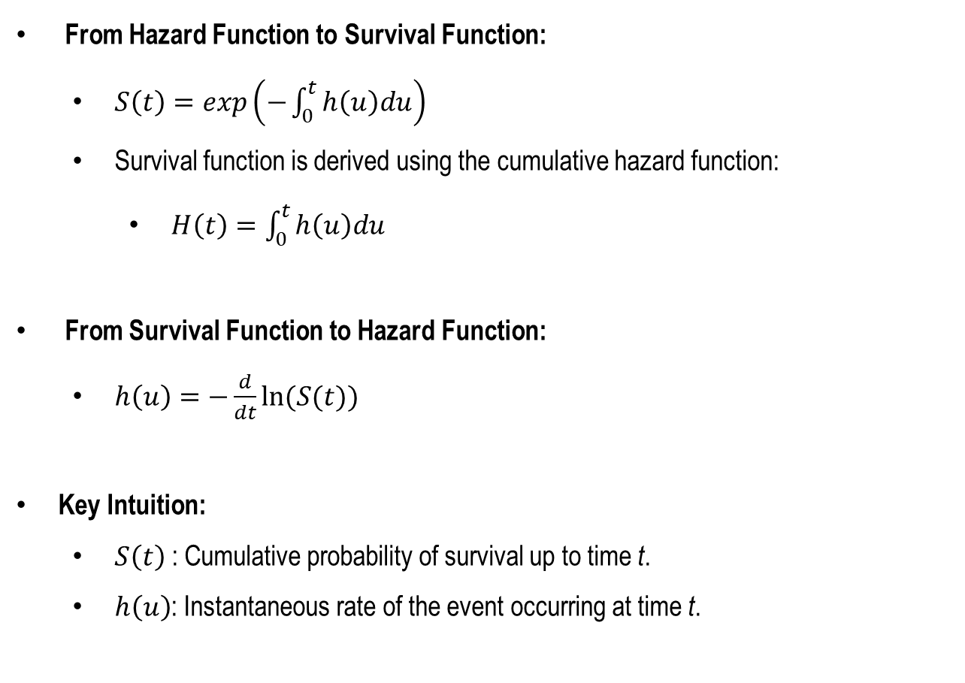
Relationship Between S(t) and h(t)
From Hazard Function to Survival Function:
$S\left(t\right)=exp\left(−\int_{0}^{t}{h\left(u\right)du}\right)⁡$
Survival function is derived using the cumulative hazard function:
$H\left(t\right)=\int_{0}^{t}{h\left(u\right)du}$
From Survival Function to Hazard Function:
$h\left(u\right)=−\frac{d}{dt}ln⁡(S(t))$
Key Intuition:
$S\left(t\right)$: Cumulative probability of survival up to time t.
$h\left(u\right)$: Instantaneous rate of the event occurring at time t.

Slide 10
Relationship Between S(t) and h(t)
From Hazard Function to Survival Function:
$S\left(t\right)=exp\left(−\int_{0}^{t}{h\left(u\right)du}\right)⁡$
Survival function is derived using the cumulative hazard function:
$H\left(t\right)=\int_{0}^{t}{h\left(u\right)du}$
From Survival Function to Hazard Function:
$h\left(u\right)=−\frac{d}{dt}ln⁡(S(t))$
Key Intuition:
$S\left(t\right)$: Cumulative probability of survival up to time t.
$h\left(u\right)$: Instantaneous rate of the event occurring at time t.
Inversely related

Slide 11
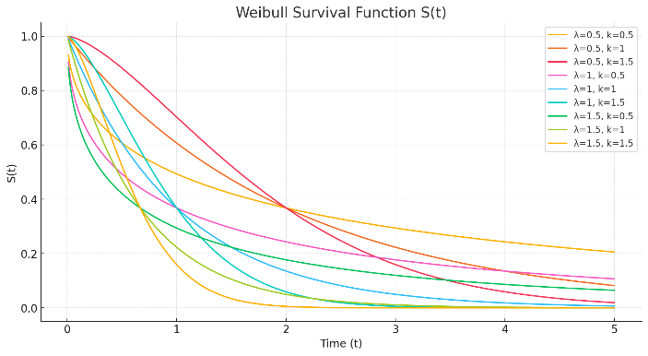
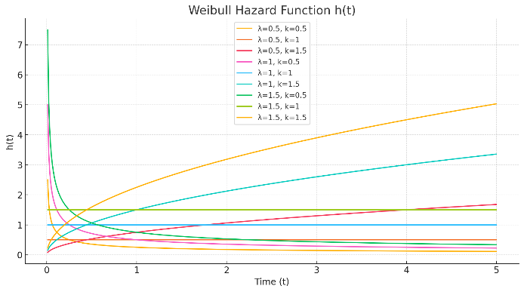
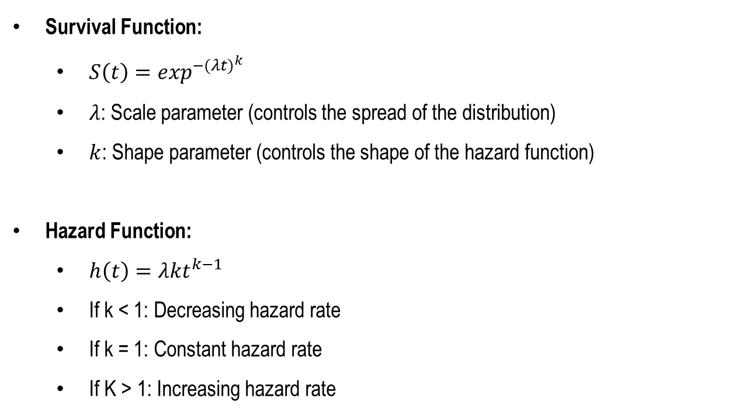
Special Case of S(t) and h(t)
Survival Function:
$S\left(t\right)=\exp^{−{(λt)}^{k}}⁡$
$λ$: Scale parameter (controls the spread of the distribution)
$k$: Shape parameter (controls the shape of the hazard function)
Hazard Function:
$h\left(t\right)=λkt^{k−1}$
If k < 1: Decreasing hazard rate
If k = 1: Constant hazard rate
If K > 1: Increasing hazard rate

Slide 12


Challenges in Survival Analysis
Key challenges:
Right-censoring: Some events are not observed due to time limitations.
Heterogeneous baseline hazards: Differences across subgroups lead to biased results under a single baseline hazard assumption.
Limited data in high-dimensional settings (e.g., genomics).
Start
End
Current
Risk
Group1
Right
censored
Right
censored
Group2
$$t$$
$$t$$
Right-censoring
Heterogeneous baseline hazards

Slide 13
Handling Heterogeneous Baseline Hazards
Ignoring the baseline hazard
Cox Proportional Hazards Model
Incorporating heterogeneous baseline hazards into modeling
Stratified Cox Model → Stratified neural network for Cox Model

Slide 14
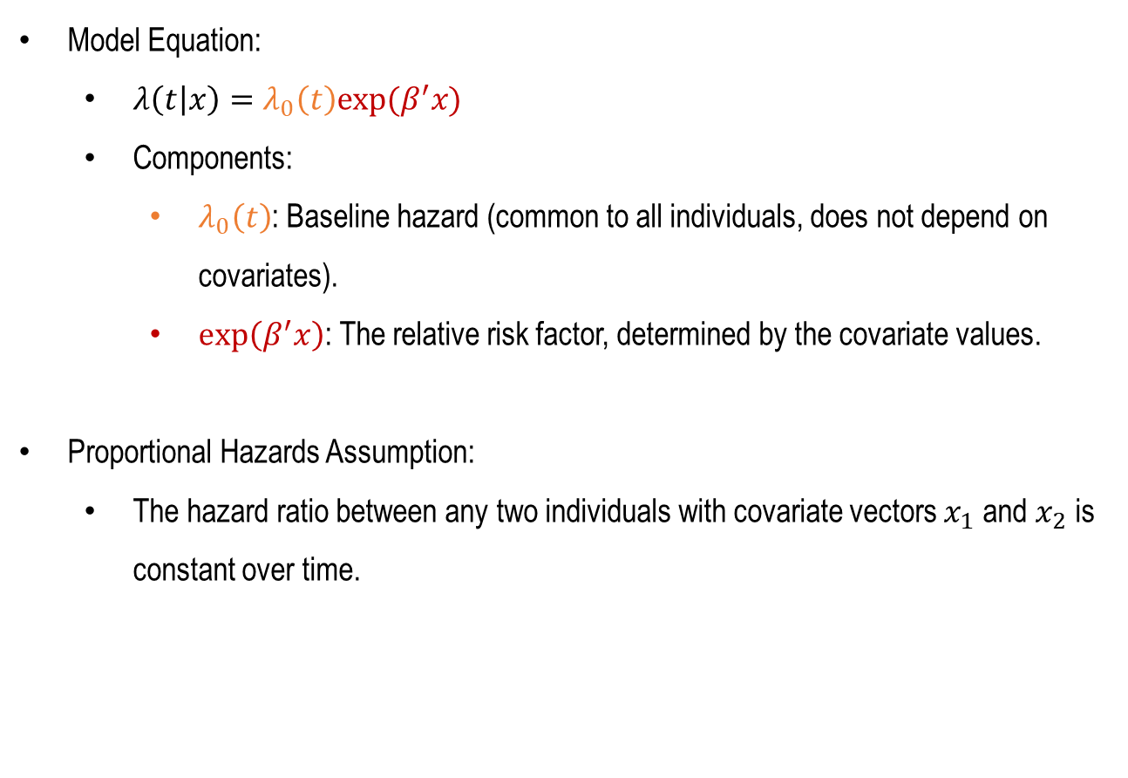
Cox Proportional Hazards Model Overview
Model Equation:
$λ\left(t | x\right)=λ_{0}\left(t\right)exp⁡(β^{′}x)$
Components:
$λ_{0}\left(t\right)$: Baseline hazard (common to all individuals, does not depend on covariates).
$\exp\left(β^{′}x\right)$: The relative risk factor, determined by the covariate values.
Proportional Hazards Assumption:
The hazard ratio between any two individuals with covariate vectors $x_{1}$ and $x_{2}$ is constant over time.

Slide 15
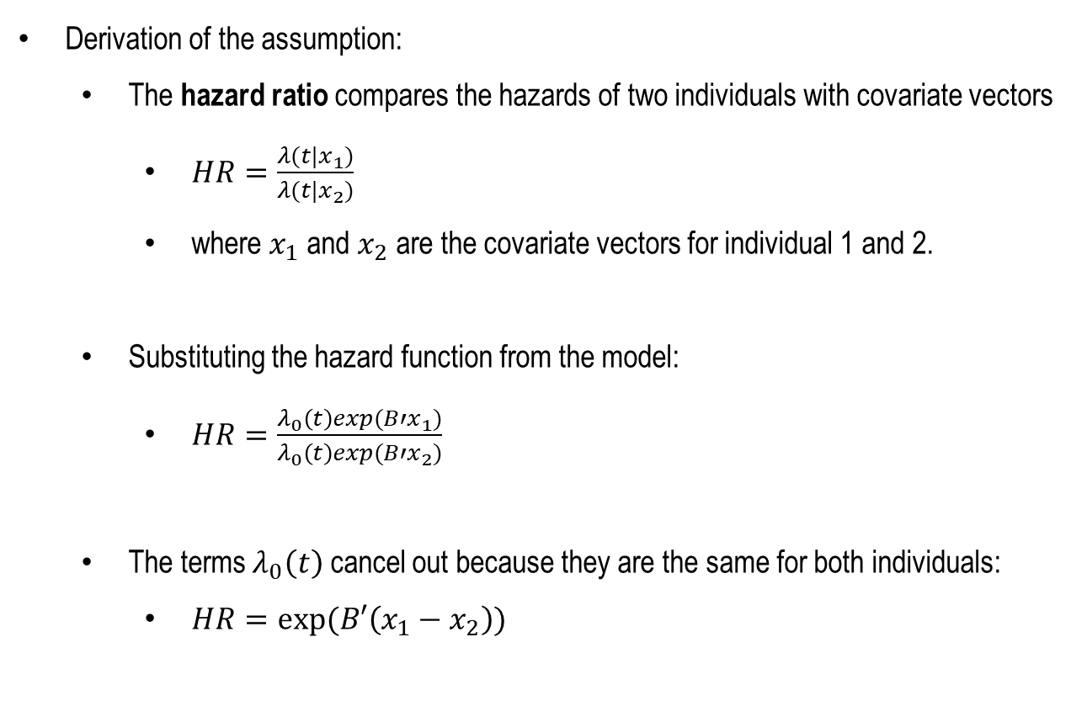
Cox Proportional Hazards Model Overview
Derivation of the assumption:
The hazard ratio compares the hazards of two individuals with covariate vectors
$HR=\frac{λ(t|x_{1})}{λ(t|x_{2})}$
where $x_{1}$ and $x_{2}$ are the covariate vectors for individual 1 and 2.
Substituting the hazard function from the model:
$HR=\frac{λ_{0}\left(t\right)exp(B′x_{1})}{λ_{0}\left(t\right)exp(B′x_{2})}$
The terms $λ_{0}\left(t\right)$ cancel out because they are the same for both individuals:
$HR=exp⁡(B′\left(x_{1}−x_{2}\right))$

Slide 16
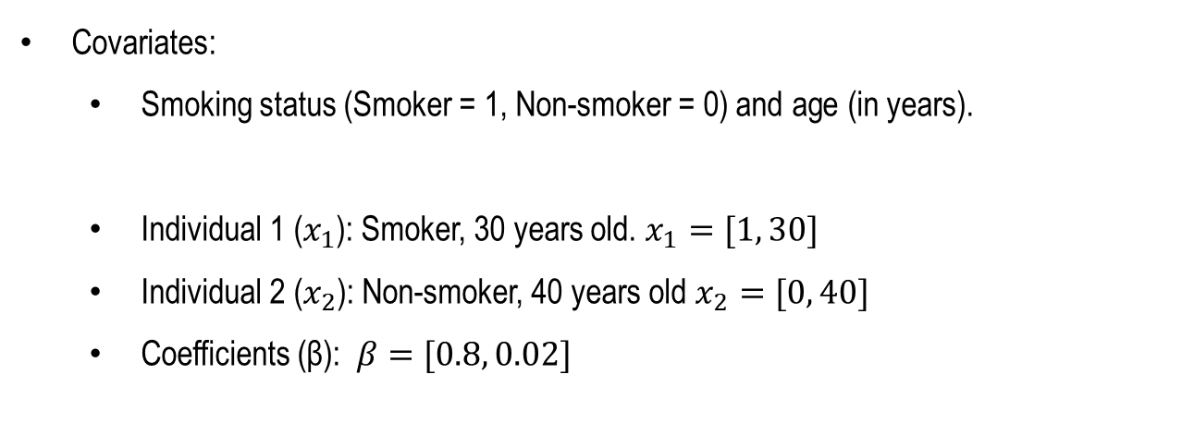
Cox Proportional Hazards Model Example
Covariates:
Smoking status (Smoker = 1, Non-smoker = 0) and age (in years).
Individual 1 ($x_{1}$): Smoker, 30 years old. $x_{1}=[1, 30]$
Individual 2 ($x_{2}$​): Non-smoker, 40 years old $x_{2}=[0, 40]$
Coefficients (β): $β=[0.8, 0.02]$

Slide 17
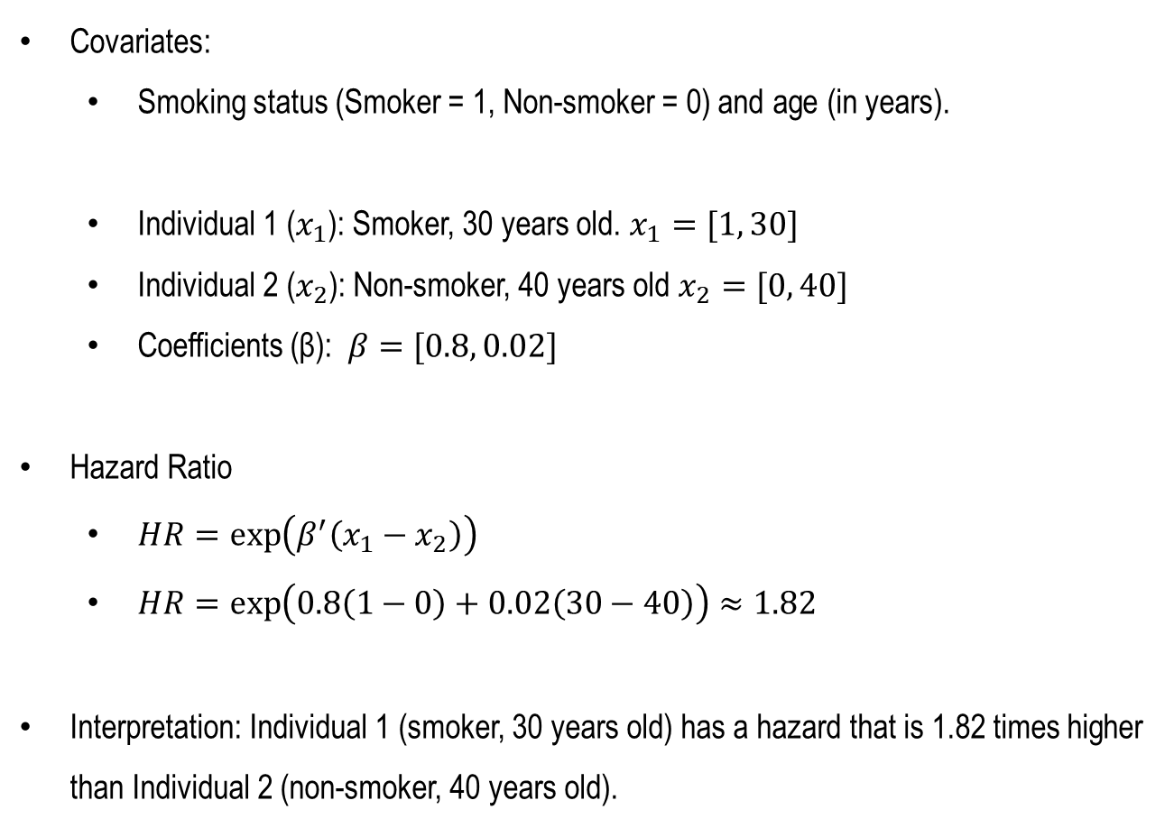
Cox Proportional Hazards Model Example
Covariates:
Smoking status (Smoker = 1, Non-smoker = 0) and age (in years).
Individual 1 ($x_{1}$): Smoker, 30 years old. $x_{1}=[1, 30]$
Individual 2 ($x_{2}$​): Non-smoker, 40 years old $x_{2}=[0, 40]$
Coefficients (β): $β=[0.8, 0.02]$
Hazard Ratio
$HR=\exp\left(β^{′}\left(x_{1}−x_{2}\right)\right)$
$HR=\exp\left(0.8\left(1−0\right)+0.02\left(30−40\right)\right)≈1.82$
Interpretation: Individual 1 (smoker, 30 years old) has a hazard that is 1.82 times higher than Individual 2 (non-smoker, 40 years old).

Slide 18
Chapter 2
General Survival Analysis with MLE

Slide 19
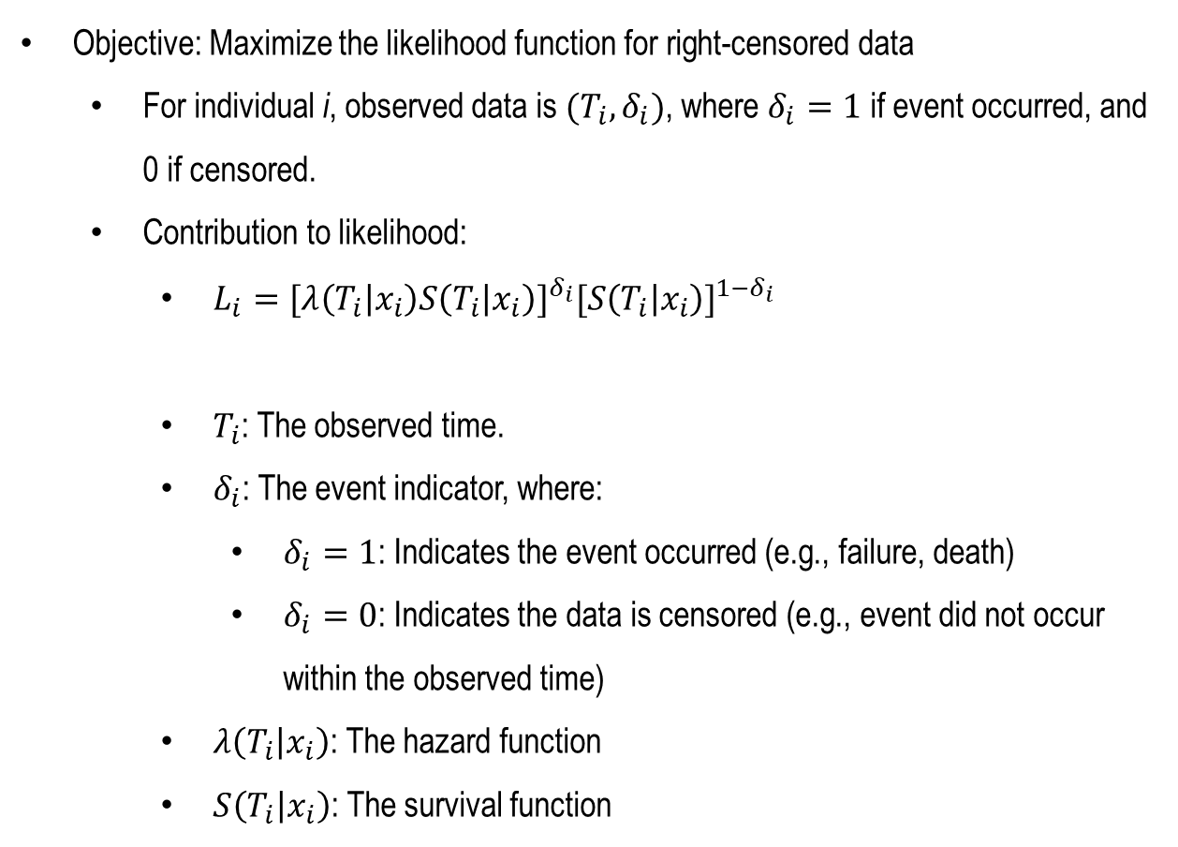
Likelihood for Censored Data
Objective: Maximize the likelihood function for right-censored data
For individual i, observed data is $(T_{i},δ_{i})$, where $δ_{i}=1$ if event occurred, and 0 if censored.
Contribution to likelihood:
$L_{i}={[λ\left(T_{i} | x_{i}\right)S\left(T_{i} | x_{i}\right)]}^{δ_{i}}{[S\left(T_{i} | x_{i}\right)]}^{1−δ_{i}}$
$T_{i}$: The observed time.
$δ_{i}$: The event indicator, where:
$δ_{i}=1$: Indicates the event occurred (e.g., failure, death)
$δ_{i}=0$: Indicates the data is censored (e.g., event did not occur within the observed time)
$λ\left(T_{i} | x_{i}\right)$: The hazard function
$S\left(T_{i} | x_{i}\right)$: The survival function

Slide 20
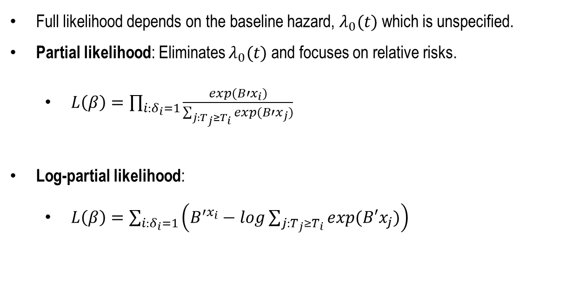
Partial Likelihood in the Cox Model
Full likelihood depends on the baseline hazard, $λ_{0}(t)$which is unspecified.
Partial likelihood: Eliminates $λ_{0}(t)$and focuses on relative risks.
$L\left(β\right)=\prod_{i:δ_{i}=1}{\frac{exp(B′x_{i})}{\sum_{j:T_{j}≥T_{i}}{exp(B′x_{j})}}}$
Log-partial likelihood:
$L\left(β\right)=\sum_{i:δ_{i}=1}{\left(B^{′x_{i}}−log\sum_{j:T_{j}≥T_{i}}{exp(B′x_{j})}\right)}$

Slide 21
Limitations of General MLE
Assumes a single baseline hazard for all individuals.
Heterogeneity problem: When baseline hazards differ (e.g., different tumor types), estimates of β become biased.
Prediction performance degrades for pooled datasets.

Slide 22
Chapter 3
Stratified Survival Analysis

Slide 23
The Need for Stratification
Motivation:
Real-world datasets often contain subgroups with distinct baseline hazards.
Example: Different cancer types in TCGA dataset.
Solution:
Stratify data into K groups based on subgroup characteristics.

Slide 24
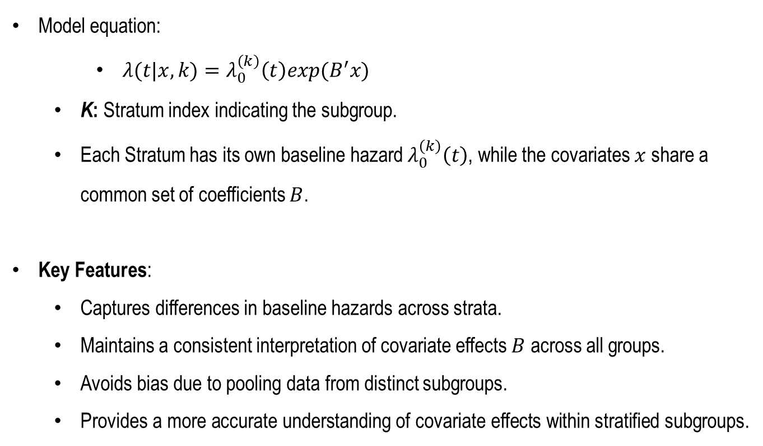
Stratified Cox Model
Model equation:
$λ(t|x,k)=λ_{0}^{\left(k\right)}\left(t\right)exp(B^{′}x)$
K: Stratum index indicating the subgroup.
Each Stratum has its own baseline hazard $λ_{0}^{\left(k\right)}\left(t\right)$, while the covariates $x$ share a common set of coefficients $B$.
Key Features:
Captures differences in baseline hazards across strata.
Maintains a consistent interpretation of covariate effects $B$ across all groups.
Avoids bias due to pooling data from distinct subgroups.
Provides a more accurate understanding of covariate effects within stratified subgroups.

Slide 25
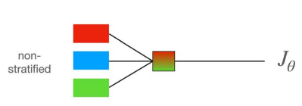
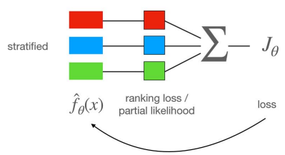
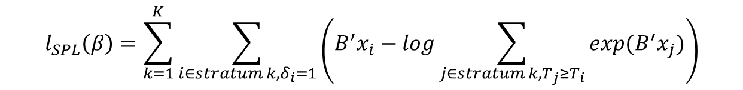
Stratified Partial Likelihood
Formula:
​Explanation:
The likelihood is computed separately for each stratum k.
The contribution of each individual is weighted based on their risk set within their stratum.
Key Properties:
Ensures model consistency within each stratum.
Reduces bias by avoiding assumptions of a shared baseline hazard across subgroups.
$$l_{SPL}\left(β\right)=\sum_{k=1}^{K}{\sum_{i∈stratum k,δ_{i}=1}{\left(B^{′}x_{i}−log\sum_{j∈stratum k,T_{j}≥T_{i}}{exp(B^{′}x_{j})}\right)}}$$

Slide 26
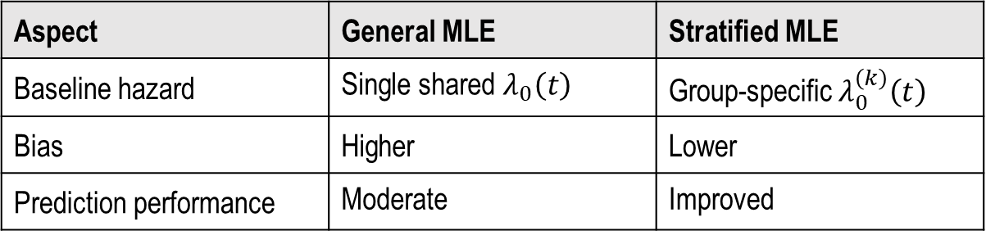
General vs. Stratified MLE
Comparison:
Aspect | General MLE | Stratified MLE
Baseline hazard | Single shared $λ_{0}\left(t\right)$ | Group-specific $λ_{0}^{\left(k\right)}\left(t\right)$
Bias | Higher | Lower
Prediction performance | Moderate | Improved

Slide 27
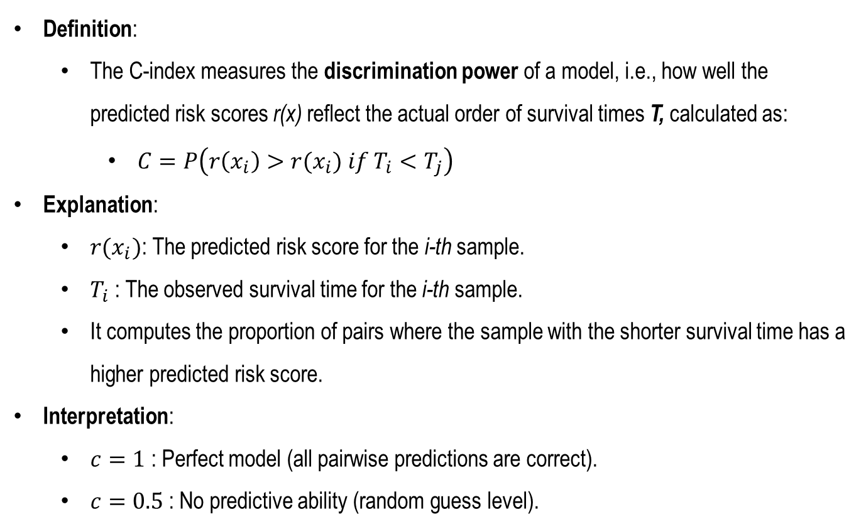
Evaluation Metrics: C-index (Concordance Index)
Definition:
The C-index measures the discrimination power of a model, i.e., how well the predicted risk scores r(x) reflect the actual order of survival times T, calculated as:
$C=P\left(r\left(x_{i}\right)>r(x_{i}) if T_{i}<T_{j}\right)$
Explanation:
$r(x_{i})$: The predicted risk score for the i-th sample.
$T_{i}$​: The observed survival time for the i-th sample.
It computes the proportion of pairs where the sample with the shorter survival time has a higher predicted risk score.
Interpretation:
$c=1$: Perfect model (all pairwise predictions are correct).
$c=0.5$: No predictive ability (random guess level).

Slide 28
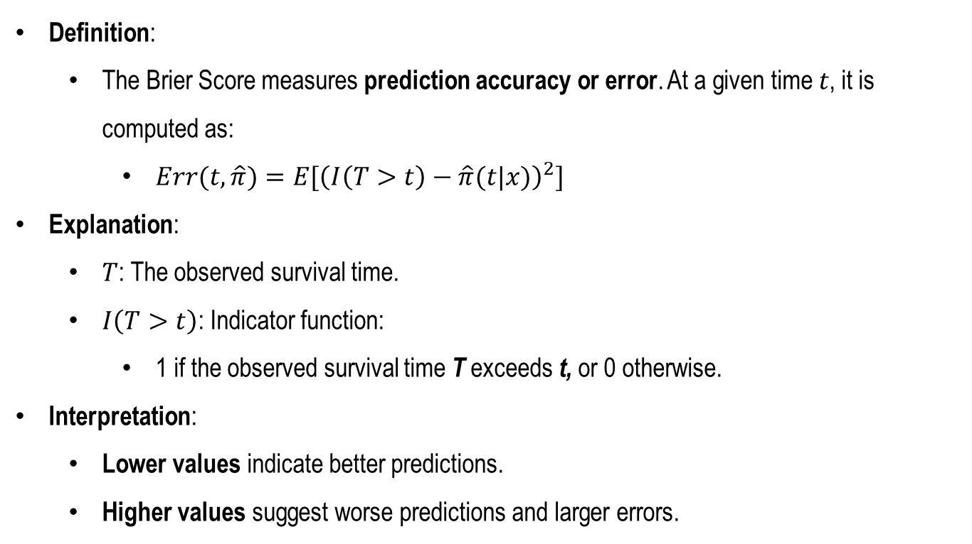
Evaluation Metrics: Brier Score
Definition:
The Brier Score measures prediction accuracy or error. At a given time 𝑡, it is computed as:
$Err(t,\hat{π})=E[{\left(I\left(T>t\right)−\hat{π}(t|x)\right)}^{2}]$
Explanation:
$T$: The observed survival time.
$I\left(T>t\right)$​: Indicator function:
1 if the observed survival time T exceeds t, or 0 otherwise.
Interpretation:
Lower values indicate better predictions.
Higher values suggest worse predictions and larger errors.

Slide 29
Comparison: C-index vs. Brier Score
Metric | C-index | Brier Score
Purpose | Evaluates the ranking ability of risk scores | Measures the prediction error
Range | [0.5 , 1] | [0,∞), typically normalized to [0, 1]
Ideal Value | Closer to 1 is better | Closer to 0 is better
Interpretation | Relative ranking performance | Absolute prediction accuracy

Slide 30
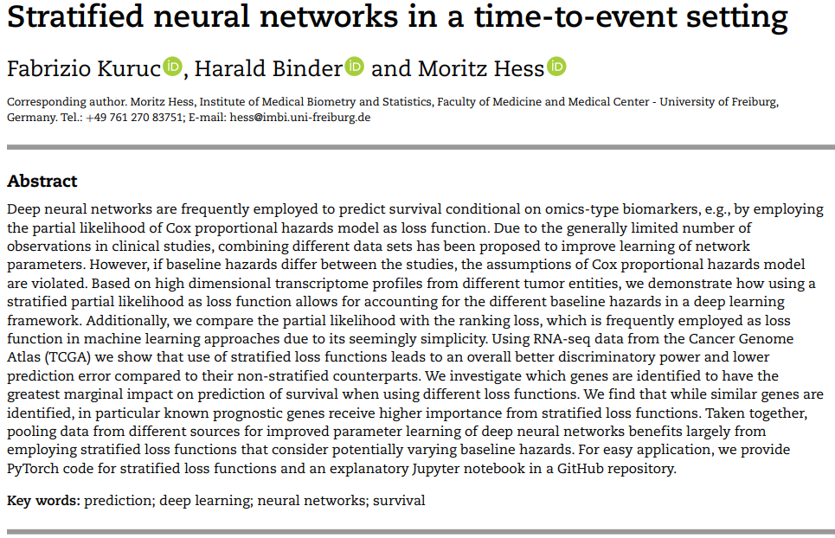
Case Study: TCGA Data
Stratified neural networks in a time-to-event setting
https://pubmed.ncbi.nlm.nih.gov/34585236/

Slide 31
Case Study: TCGA Data
Dataset Overview
Source: The Cancer Genome Atlas (TCGA) RNA-Seq data.
Details:
Covers 24 cancer types.
Stratified into three groups based on baseline hazard similarity:
BRCA (Breast Invasive Carcinoma).
GLIOMA (Glioblastoma Multiforme + Lower Grade Glioma).
KIPAN (Pan-kidney cancers: Renal Cell Carcinomas).
Data Dimensions:
∼3,000 genes selected based on variance filtering.
Training size: ∼2,470 samples across three groups.

Slide 32
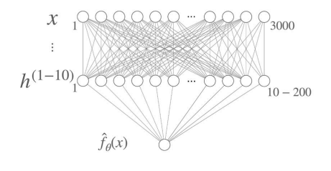
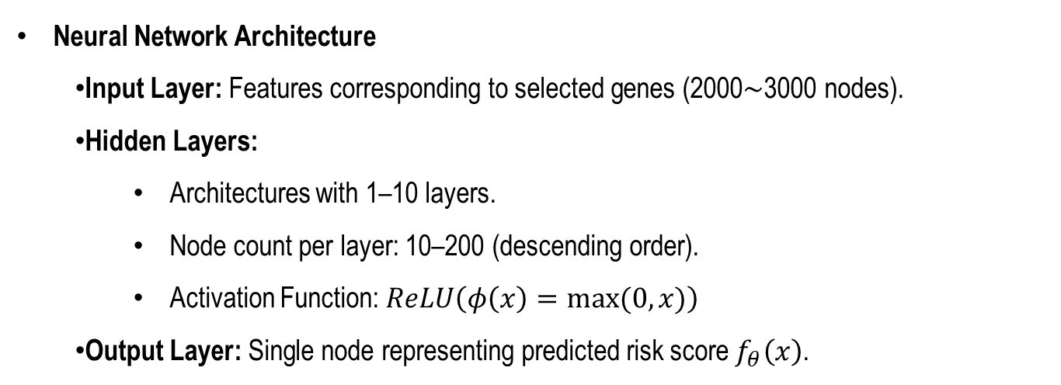
Case Study: TCGA Data
Neural Network Architecture
Input Layer: Features corresponding to selected genes (2000∼3000 nodes).
Hidden Layers:
Architectures with 1–10 layers.
Node count per layer: 10–200 (descending order).
Activation Function: $ReLU\left(φ\left(x\right)=max⁡(0,x)\right)$
Output Layer: Single node representing predicted risk score $f_{θ}\left(x\right)$.

Slide 33
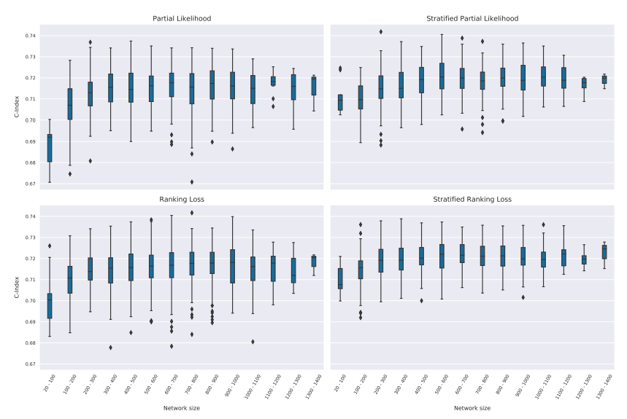
Case Study: TCGA Data
Results

Slide 34
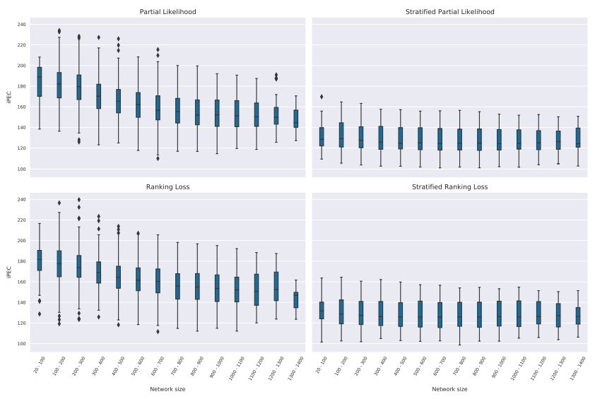
Case Study: TCGA Data
Results

